Slide 1




SEye Project
Team : RPSU CSE
R. P. Shaha University

Slide 2
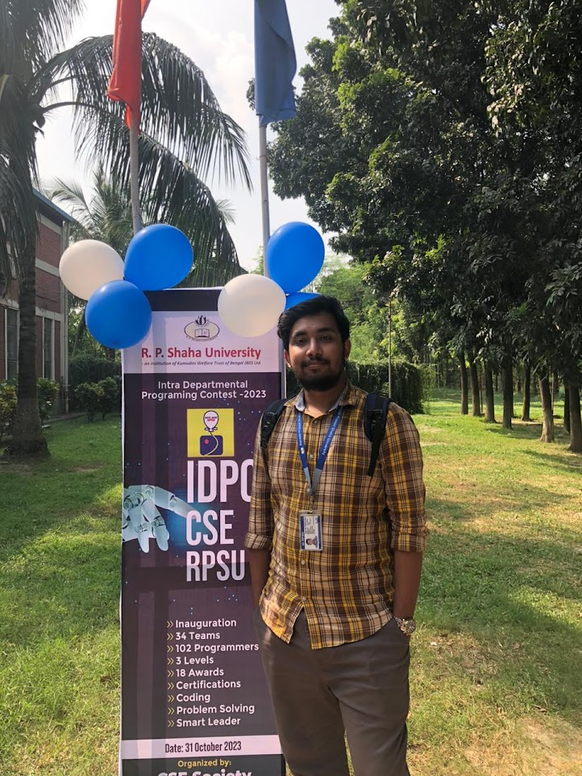
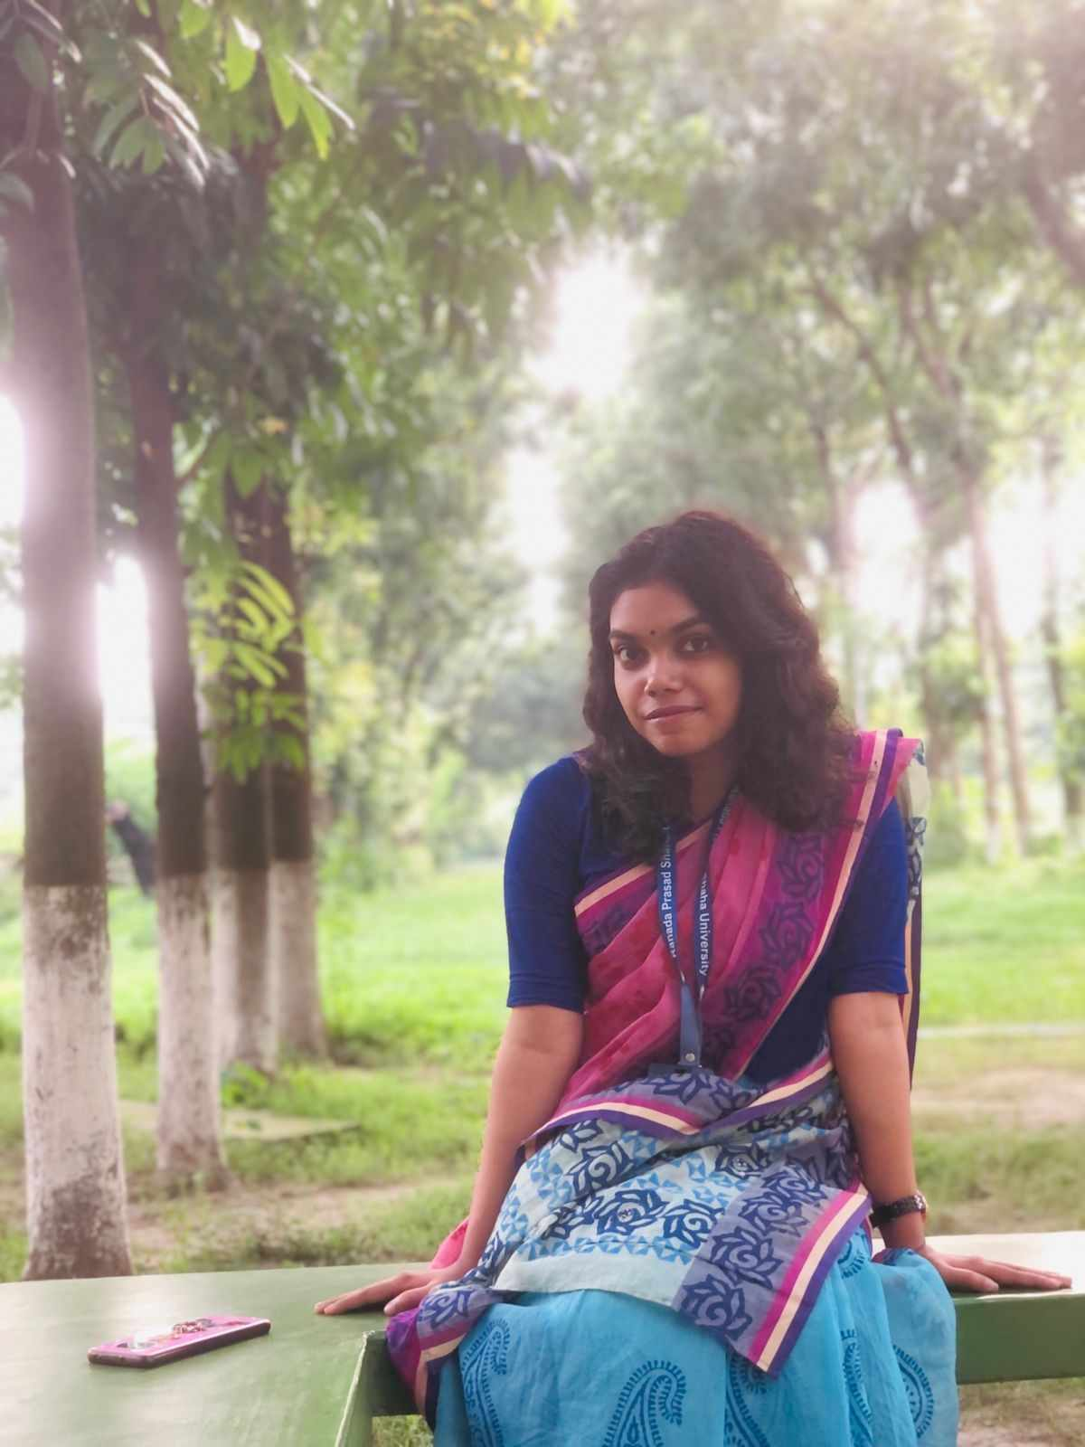
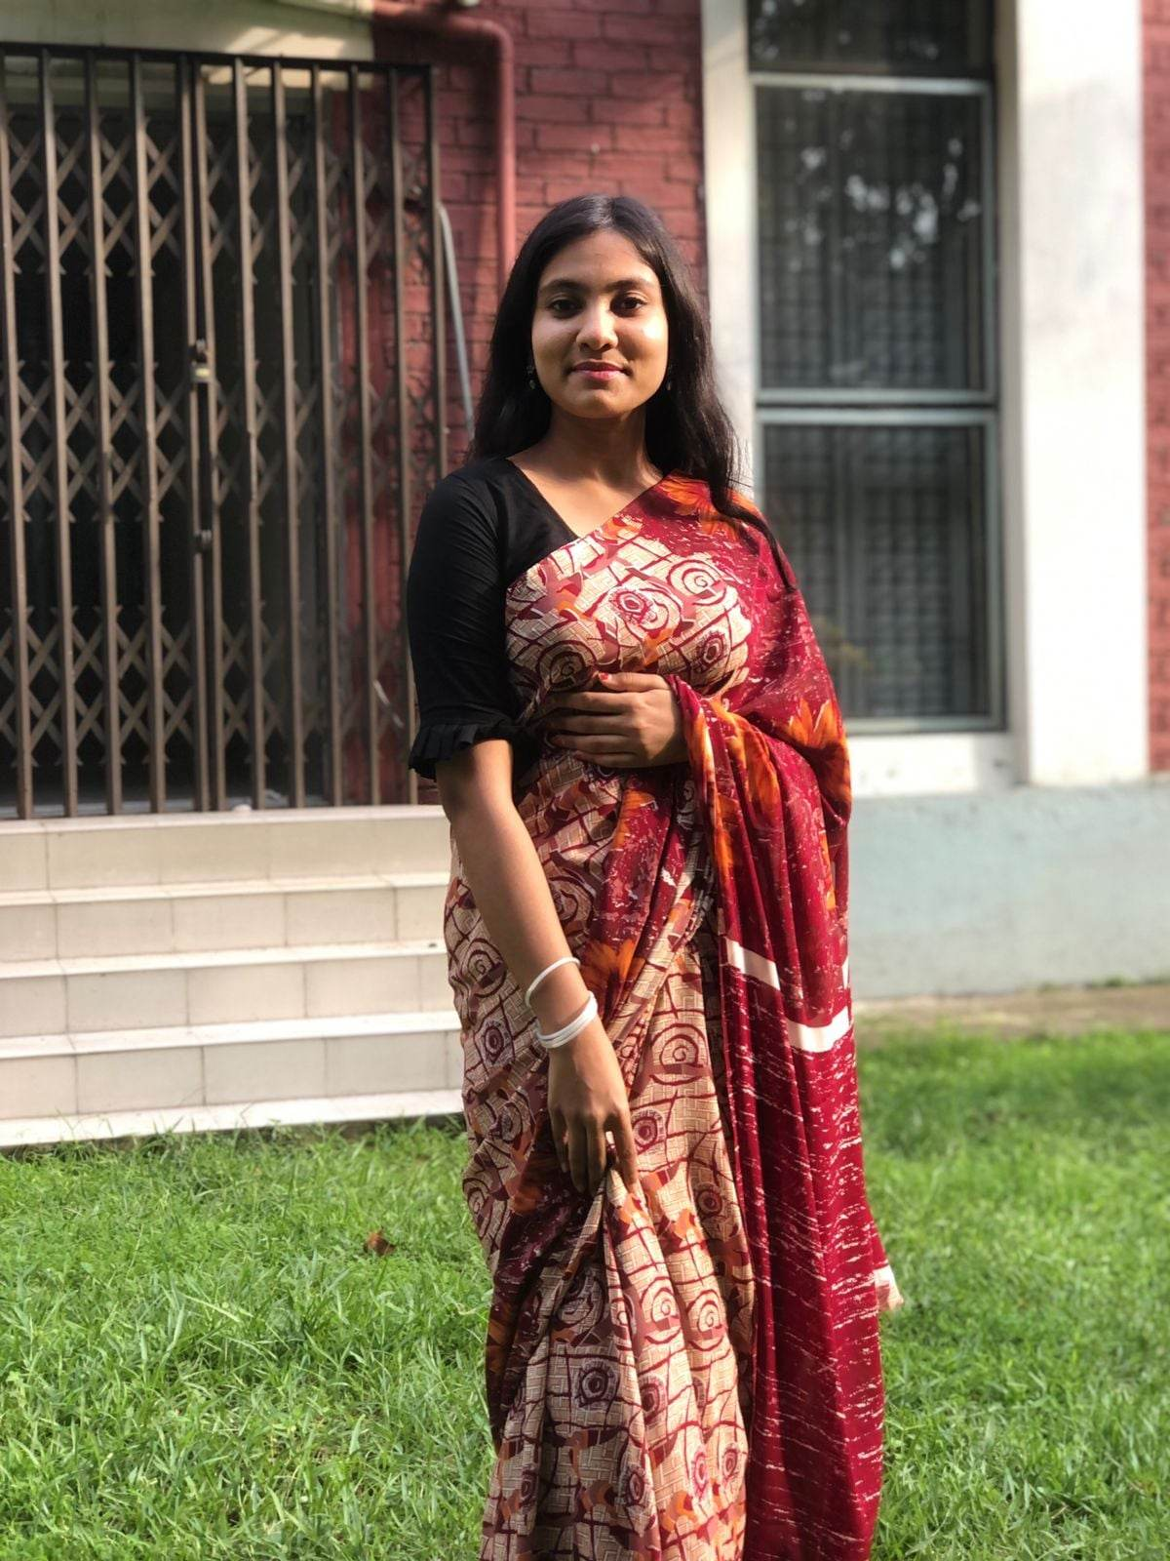
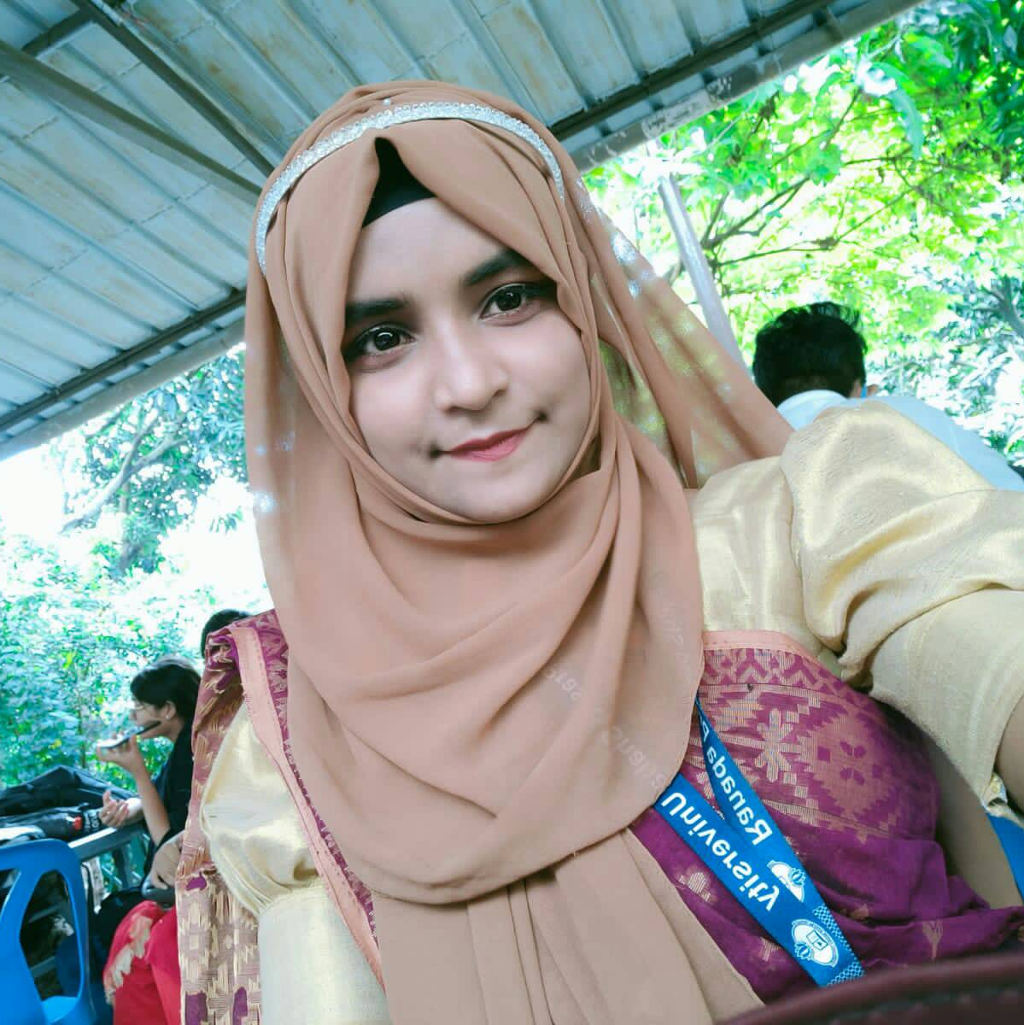
Team
01
02
03
04
Md. Tyibor Rahman
Sem: 4th RPSU
Pos: Developer
Arpita Das
Sem: 4th RPSU
Pos: Leader and Team Management
Umme Habiba Sawme
Sem: 4th RPSU
Pos: Designer
Sayma Islam
Sem: 4th RPSU
Pos: Architect

Slide 3
SEye Project
It’s a Security camera management System using Face Recognition and Web Application as User Interface

Slide 4
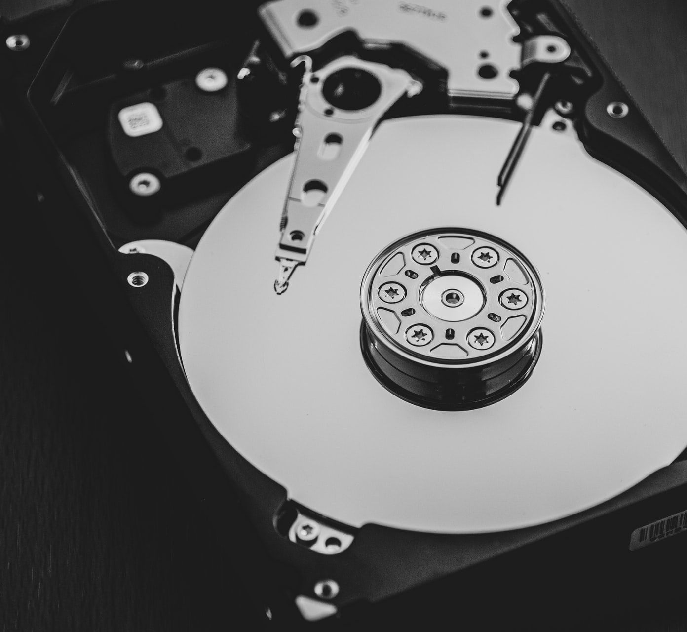

Real life Problem
Problem With normal Security Camera
Lots of Space problem
High Cost for Disk
Search For Someone by Watching videos

Slide 5
Our idea
TOPICS
Make A face – Recognition System which can read camera input and instead of saving every frames like video its saves then faces only if its unknown
Every Person got a Unique id called Person_ID . Also every Faces got Unique Id Called Face_iD
Make A Timeline Page Where every captured faces exist

Slide 6
Structure
UI
We are using FLASK (python) For Web Application As our UI
Databases
Two kind of DB JSON Type and Normal DB 1. TinyDB (python) For Logs
2. SQLITE (flask_SQLAlchemy) For Main DB
Backend
(Face_recognition) [ Adam Geitgey ] , open-cv for camera , flask (jinja also),
html , CSS, bootstrap , JavaScript's

Slide 7
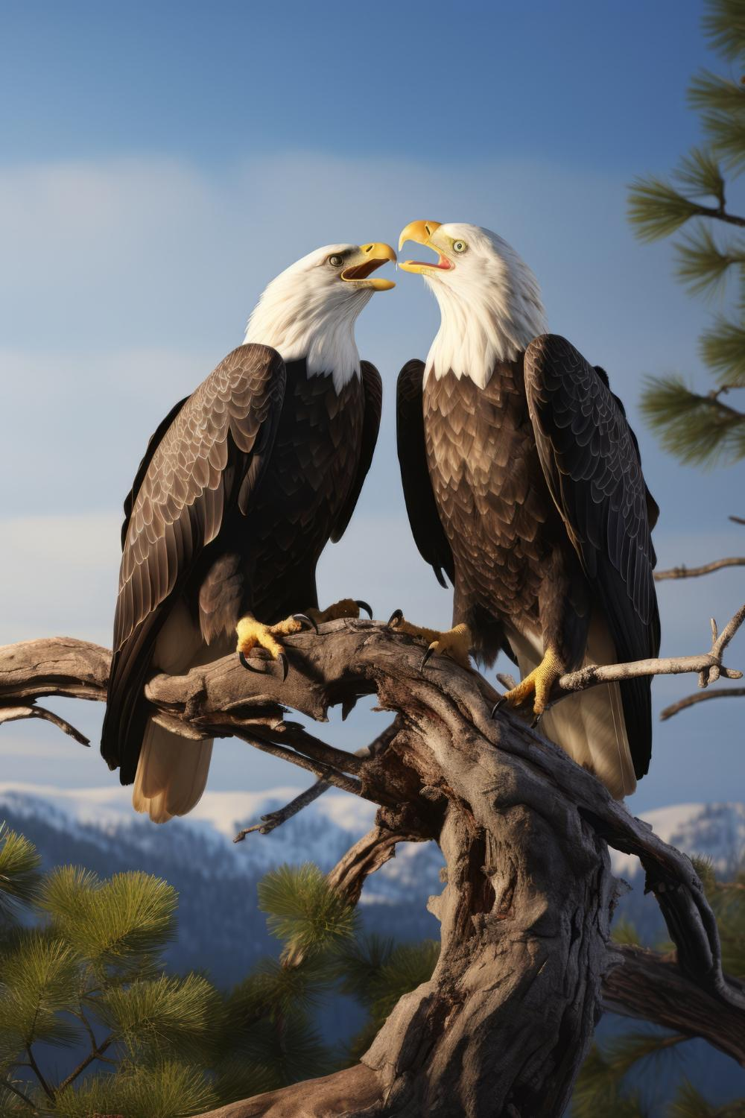
Project Presenting Sorry ( For project Under constriction)
Thank You
References: Slides go
Google images

